Slide 1
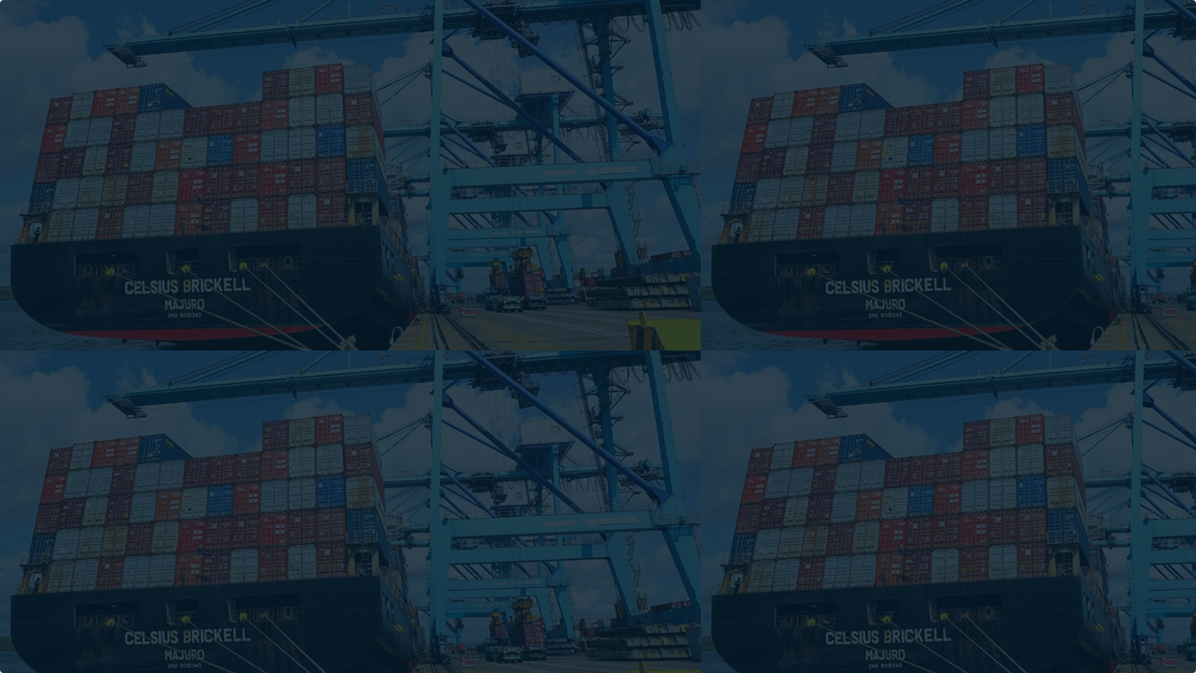
Optimizing Liquidity vs. Supply Chain Risk
Operational Value-at-Risk (OpVaR) Modeling
Case Study: Nairobi Distributor
Technical Lead (Python/Stochastic Simulation) | February 2026

Slide 2

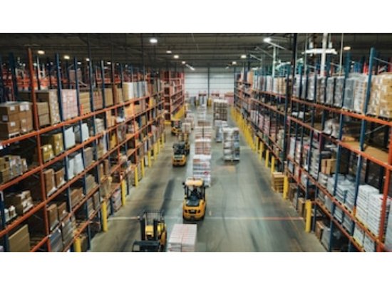

The Business Challenge
The $2M Standoff
Context: A major FMCG distributor in Nairobi facing rising working capital costs due to high interest rates.
The Conflict:
•
CFO: Demands $2M reduction in inventory holding to unlock liquidity.
•
SC Director: Refuses cuts, citing volatile lead times (Mombasa Port) and fear of stockouts.
"If we cut inventory by 20%, what is the exact statistical probability that we will fail to deliver?"

Slide 3






Methodology: Beyond Excel Averages
The Flaw of Averages
Stochastic Modeling
Monte Carlo Simulation
Standard Excel analysis uses "average lead times" (e.g., 14 days), failing to account for supply chain shocks like port delays or customs holds.
Instead of single values, we modeled distributions: Demand volatility (Normal) and Lead-time variance (Log-Normal) to capture "Long Tail" risks.
Simulated 10,000 discrete future scenarios using Python to generate a probability surface for stockouts under various inventory policies.

Slide 4


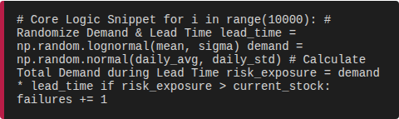
The Analytical Engine
Python + NumPy + Pandas
We built a custom simulation engine to test inventory policies against thousands of potential futures.
Output: A definitive "Risk Curve" visualizing the trade-off between Cash Released and Stockout Probability.

Slide 5
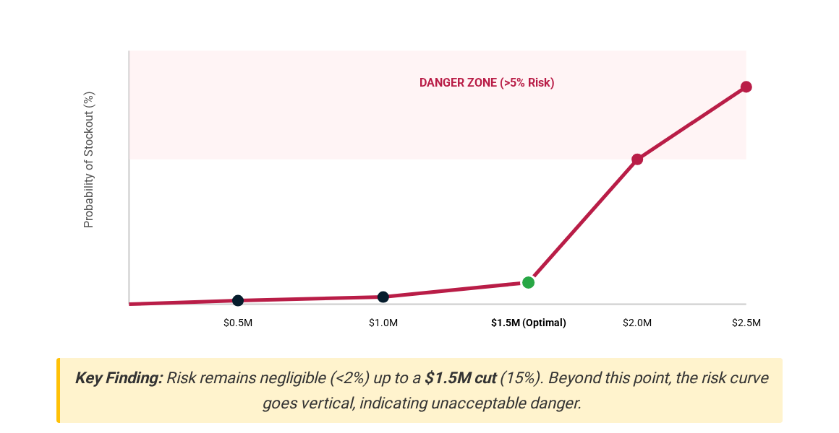
The Evidence: Optimization Trade-off

Slide 6

Strategic Recommendation
The Verdict
We recommended a Dynamic Tiered Stocking Policy rather than a blanket cut.
•
Tier A (High Volatility SKUs):
Maintain current safety stock coverage. These items drive the "long tail" risk.
•
Tier B (Stable SKUs):
Aggressively cut buffers by 20%. Demand is predictable enough to weather lead-time variance.

Slide 7
Business Impact
$1.5M
98.5%
0
WORKING CAPITAL UNLOCKED
SERVICE LEVEL MAINTAINED
OPERATIONAL DISRUPTIONS
"We moved from guessing to calculating our risk appetite."

Slide 8
Thank You
This project demonstrates the power of quantitative modeling in logistics.
GitHub: github.com/mutuku-geoffrey-m
LinkedIn:linkedin.com/in/geoffrey-mutuku-86720b3a8

Slide 9




Image Sources
•
https://img.freepik.com/premium-photo/wide-shot-warehouse-filled-with-shelves-products-with-workers-using-forklifts-move-products-around-efficiently-warehouse-is-wellorganized-brightly-lit_73899-32743.jpg?w=360
Source: www.freepik.com
•
https://img.freepik.com/premium-photo/closeup-computer-screen-displaying-colorful-lines-code-representing-programming-language-syntax-software-development-coding-digital-data-it-web-development-script-monitor_256259-11608.jpg
Source: www.freepik.com
•
https://img.freepik.com/premium-photo/abstract-visualization-global-supply-chain-network-featuring-trucks-moving-across-di_1288054-27334.jpg
Source: www.freepik.com
•
https://magazine.feaffa.com/wp-content/uploads/2024/07/Transshipment-Cargo-Photo.jpg
Source: magazine.feaffa.com

